Slide 2
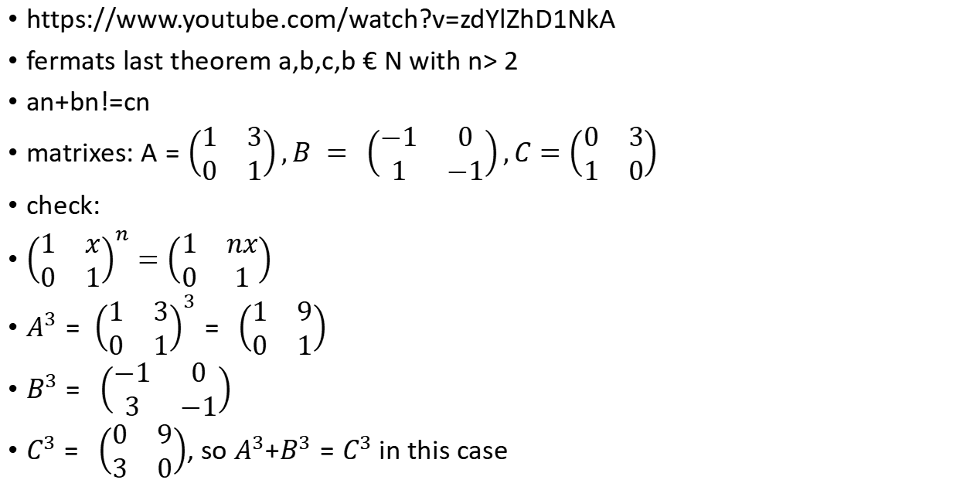
Fermat's Last Theorem for matrices?
https://www.youtube.com/watch?v=zdYlZhD1NkA
fermats last theorem a,b,c,b € N with n> 2
an+bn!=cn
matrixes:$A=\left(\begin{matrix}1 & 3 \\ 0 & 1\end{matrix}\right),B = \left(\begin{matrix}−1 & 0 \\ 1 & −1\end{matrix}\right),C=\left(\begin{matrix}0 & 3 \\ 1 & 0\end{matrix}\right)$
check:
${\left(\begin{matrix}1 & x \\ 0 & 1\end{matrix}\right)}^{n}=\left(\begin{matrix}1 & nx \\ 0 & 1\end{matrix}\right)$
$A^{3}= {\left(\begin{matrix}1 & 3 \\ 0 & 1\end{matrix}\right)}^{3}= \left(\begin{matrix}1 & 9 \\ 0 & 1\end{matrix}\right)$
$B^{3}= \left(\begin{matrix}−1 & 0 \\ 3 & −1\end{matrix}\right)$
$C^{3}= \left(\begin{matrix}0 & 9 \\ 3 & 0\end{matrix}\right)$, so $A^{3}$+$B^{3}=C^{3}$ in this case

Slide 3
fermats last teorem also does not hold for Zp
Z₅ - you reduce mod 5 after every step
1⁵+2⁵ = 1+32 = 33 ==3 (mod 5)
3⁵ = (3*3) (3*3) * 3 = -1 * -1 * 3 (mod 3 ) = 3 (mod 3)
a^{p} == a(mod p), so if we take digits a*b = c , then
a^{p} + b^{p} = c^{p} (mod p)

